Slide 1
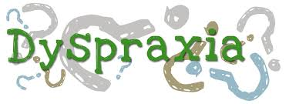

Slide 2
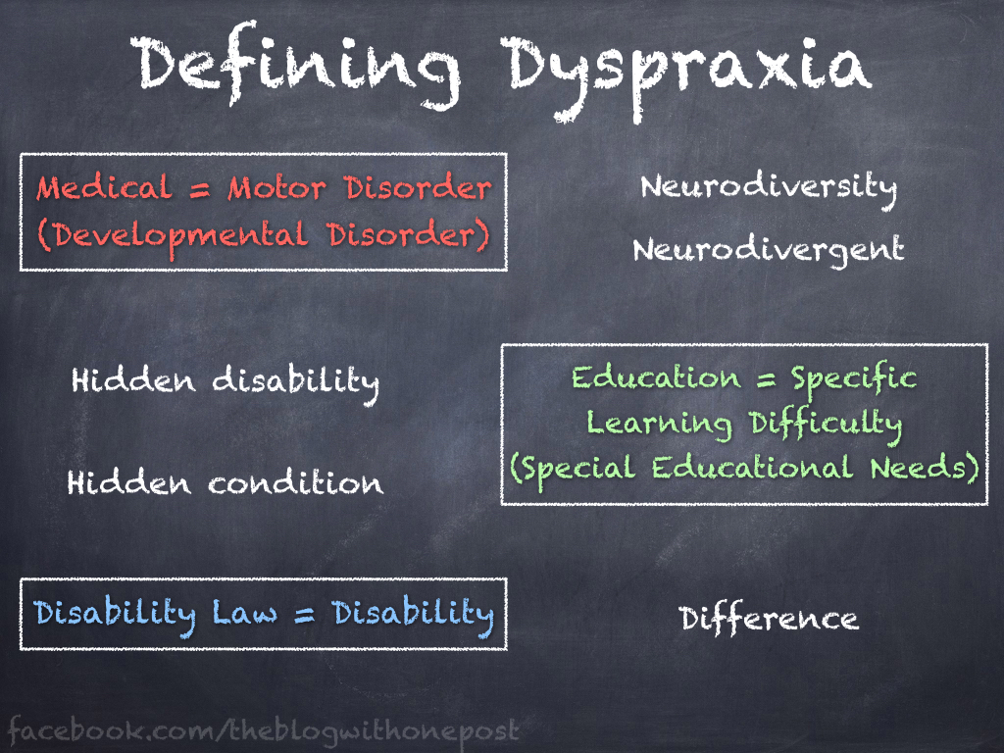
definition

Slide 3
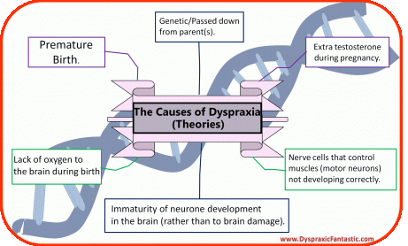

Slide 4
Symptoms Of Dyspraxia
differences in speech
poor hand-eye coordination

Slide 5
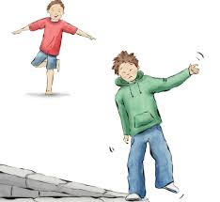
poor balance

Slide 6

Fatique

Slide 7
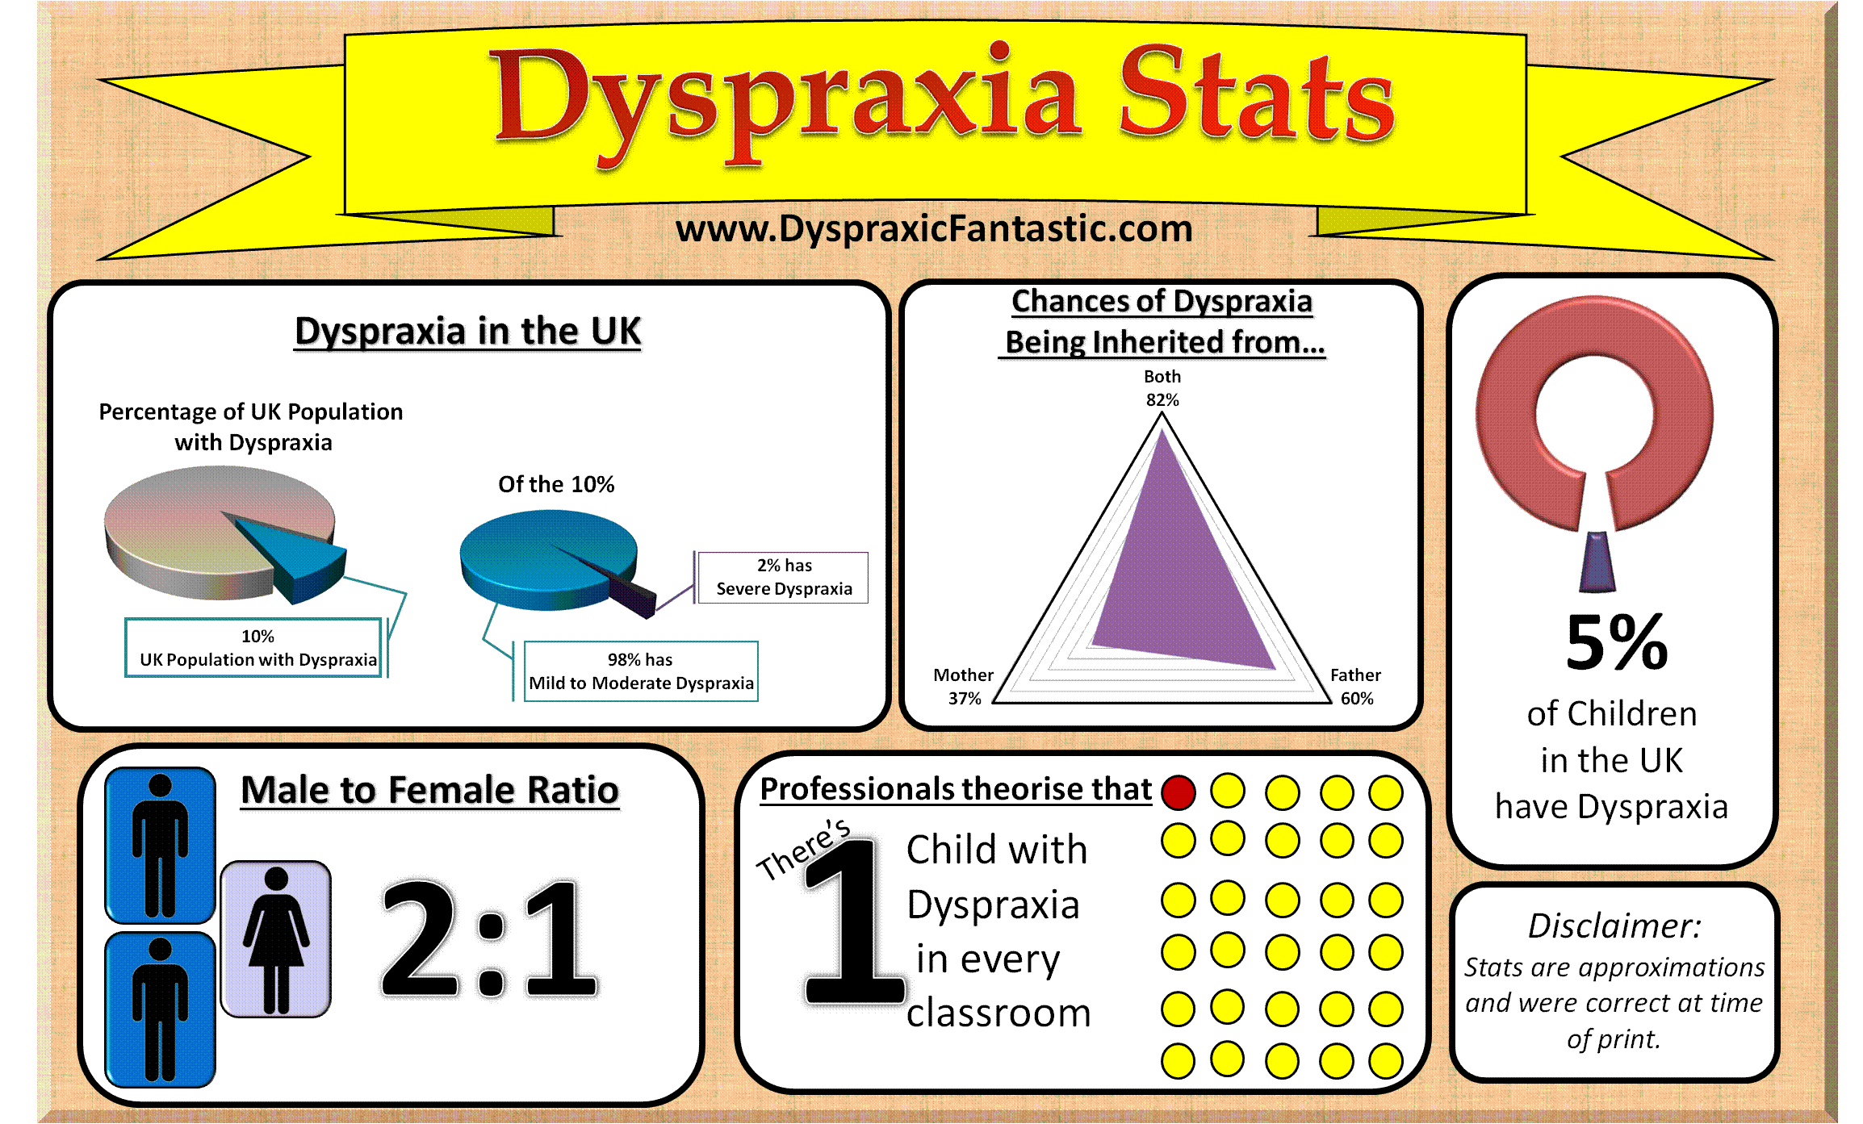

Slide 8

Technology Tools For Treat Dyspraxia
Ipad and tablets
Voice-to-Text Applications

Slide 9

Talking Tom (iOS)

Slide 10
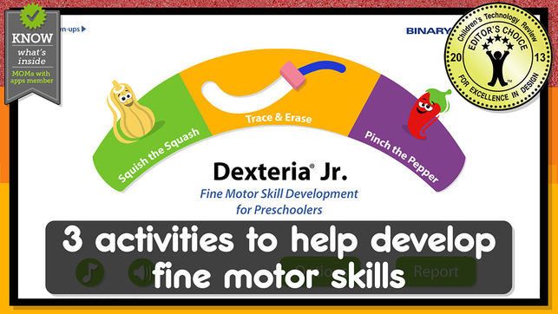
Dexteria (iOS, Android)

